Slide 1

Where Should I Live?
Kiran Devanath, Michael Good, Rejane Beringer

Slide 2
Project Requirements
Your visualization must include a Python Flask–powered RESTful API, HTML/CSS, JavaScript, and at least one database (SQL, MongoDB, SQLite).
Your project should fall into one of the below four tracks:
A custom “creative” D3.js project (i.e., a nonstandard graph or chart)
A combination of web scraping and Leaflet or Plotly
A dashboard page with multiple charts that update from the same data
A “thick” server that performs multiple manipulations on data in a database prior to visualization (must be approved)
Your project should include at least one JS library that we did not cover.
Your project must be powered by a data set with at least 100 records.
Your project must include some level of user-driven interaction (menus, dropdowns, textboxes).
Your final visualization should ideally include at least three views.

Slide 3
Where Should I Live?
Summary:
We will use the data to compare cities across the US with respect to cost of living, consumer prices, crime rates, education, and other factors. We will then recommend to the user the best places that they may want to consider for a future place to live based upon their input criteria weighted by cost of living in each location.

Slide 4
Where Should I Live?
Summary:
We will use a sequential database based upon city name as the primary key. We will use a reference table which will contain the locations of each city to be placed on the map. Our flask server will communicate with the front end webpage which will take the user’s filtering preferences in order to generate the correct city names.

Slide 5
Description
We have taken data from Numbeo, the largest "Cost of Living" database, to recommend cities for the user selects from four different options to narrow down a selection of cities:
Crime Index
Health Care Index
Pollution Index
Restaurant Price Index

Slide 6
Description
Other Datasets:
Movehub: https://www.kaggle.com/blitzr/movehub-city-rankings?select=movehubcostofliving.csv
National Parks Data - https://www.latlong.net/category/national-parks-236-42.html
Numbeo: https://www.numbeo.com/api/doc.jsp

Slide 7
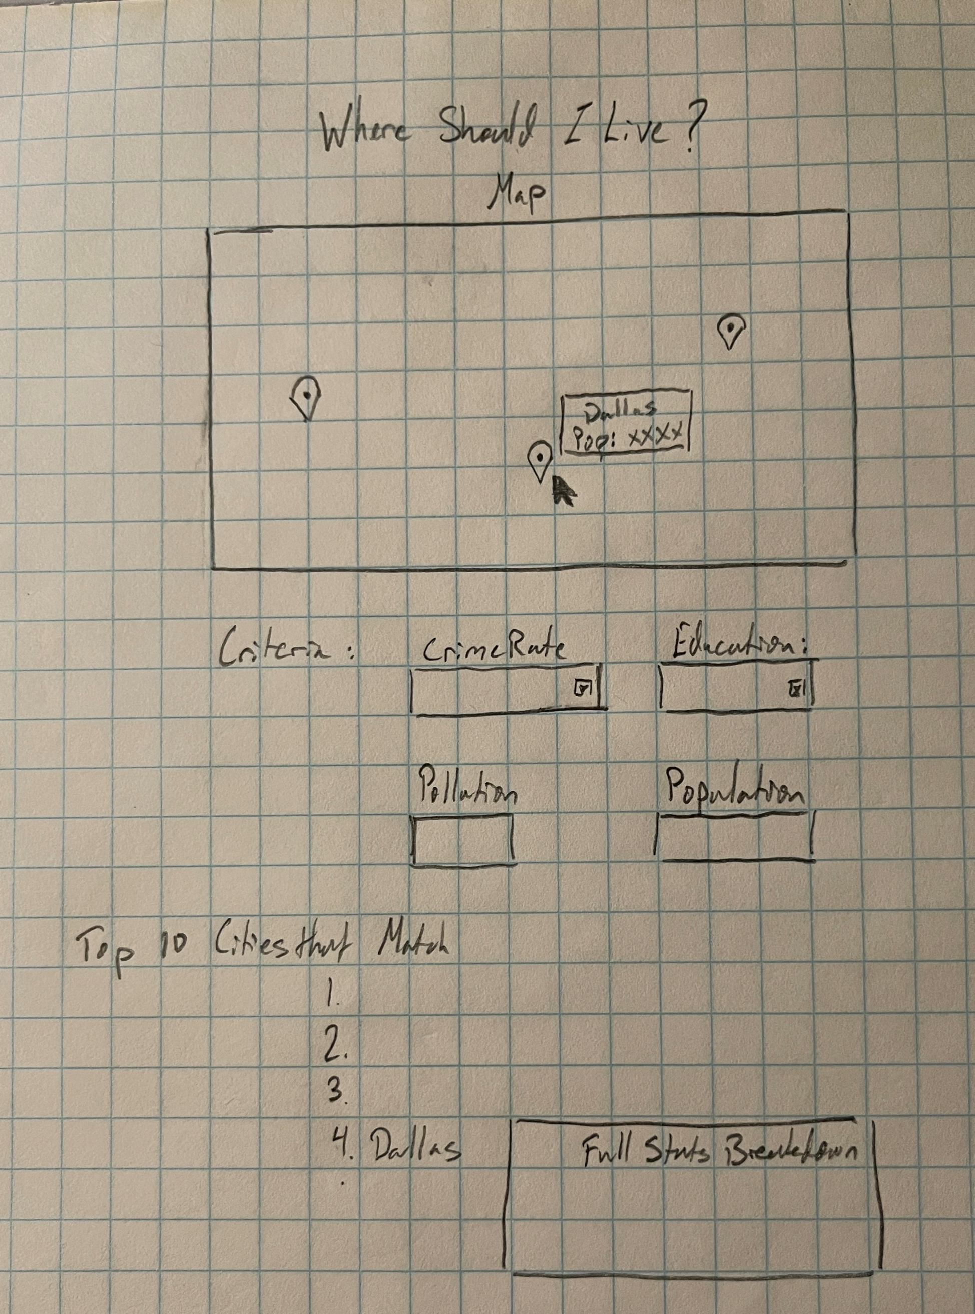
Project Proposal

Slide 8
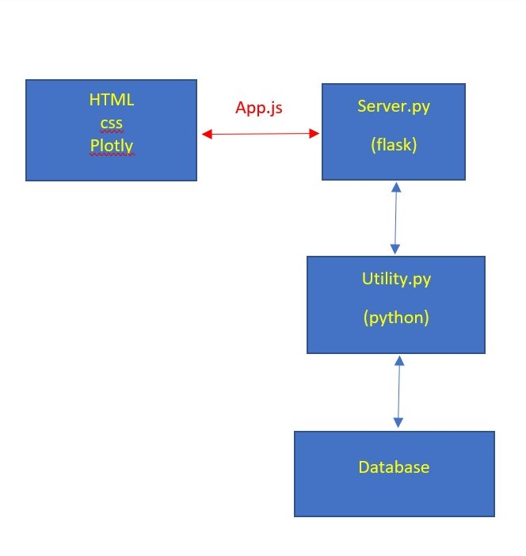
Project Proposal

Slide 9
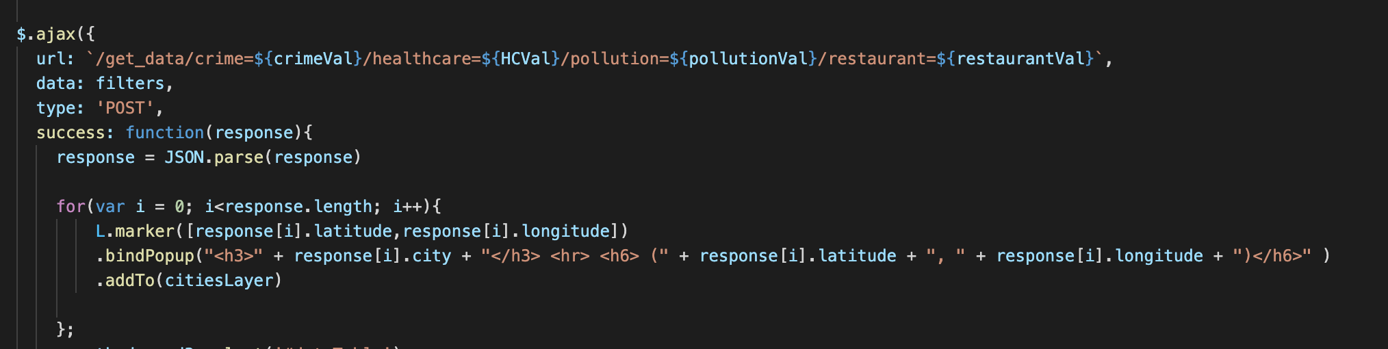
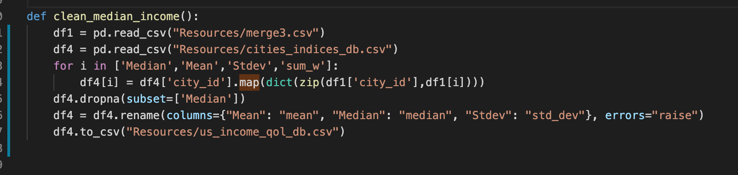

Slide 10
Visualization
Data visualization is an excellent way to transform data into interactive and –easy-to-comprehend information.
A vast amount of data well-arranged
Improving communication,
Simplifying the task of analyzing,
Allowing quicker analysis .

Slide 11
Visualization
Through this project we aimed to provide visualization of the data through of interactive and responsive visuals
Map
Table
Plot
A Home page and two redirecting pages
About
Contact

Slide 12

Home

Slide 13
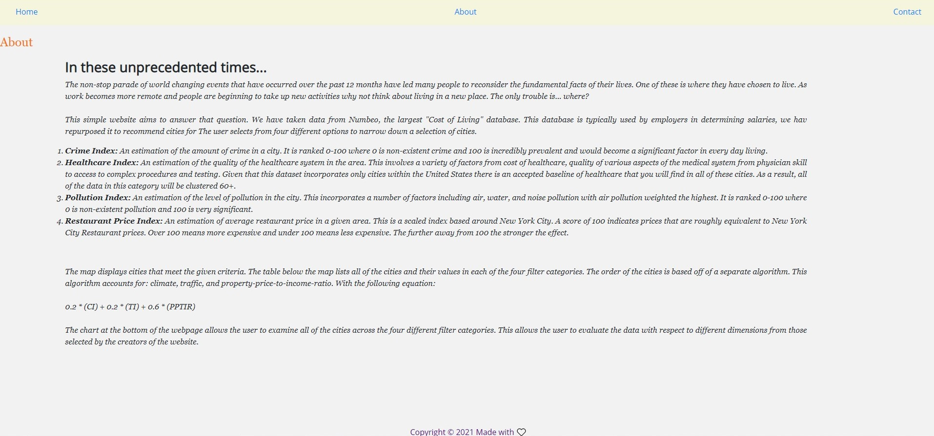
About

Slide 14
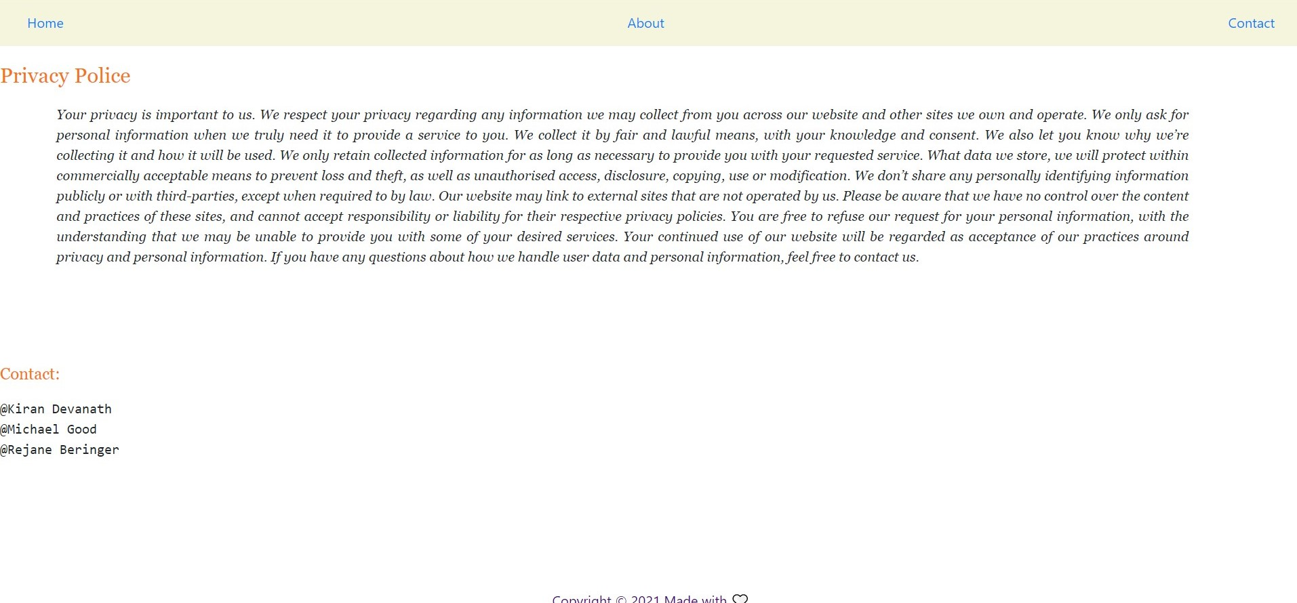
Contact

Slide 15
Visualization
The map displays cities that meet the given criteria.
The table lists all of the results and their values in each of the four filter categories.
The order of the cities is based off of a separate algorithm that accounts for: climate(CI), traffic(TI), and property-price-to-income-ratio(PPTIR).
0.2 * (CI) + 0.2 * (TI) + 0.6 * (PPTIR)
The chart allows the user to examine all of the cities across the four different filter categories.

Slide 16


Slide 17
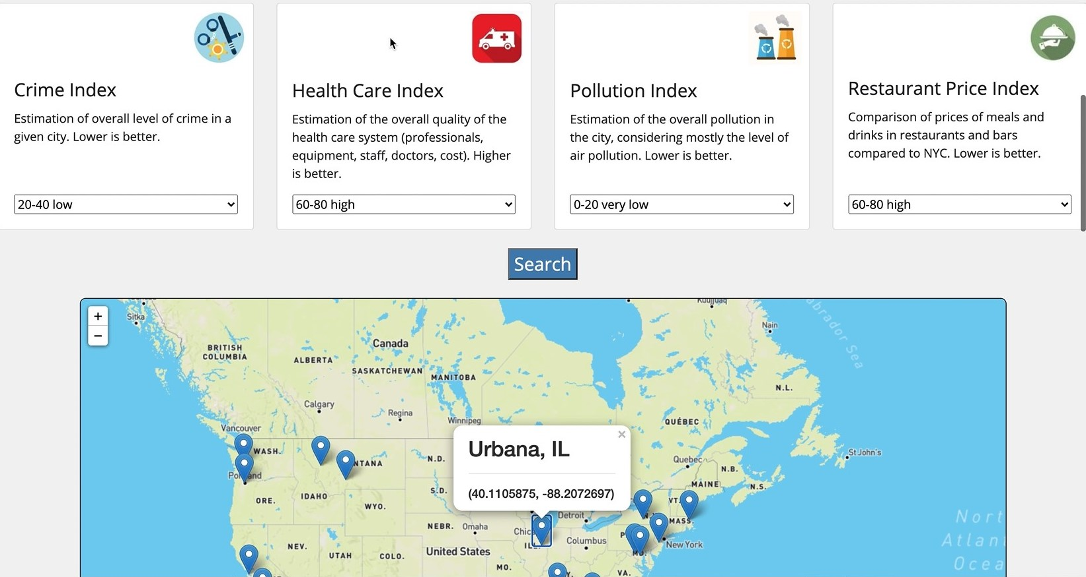

Slide 18
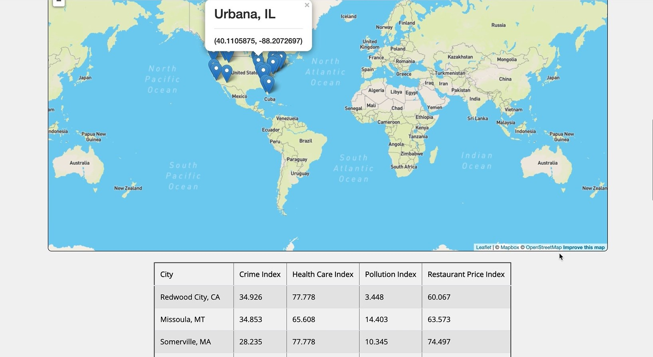

Slide 19
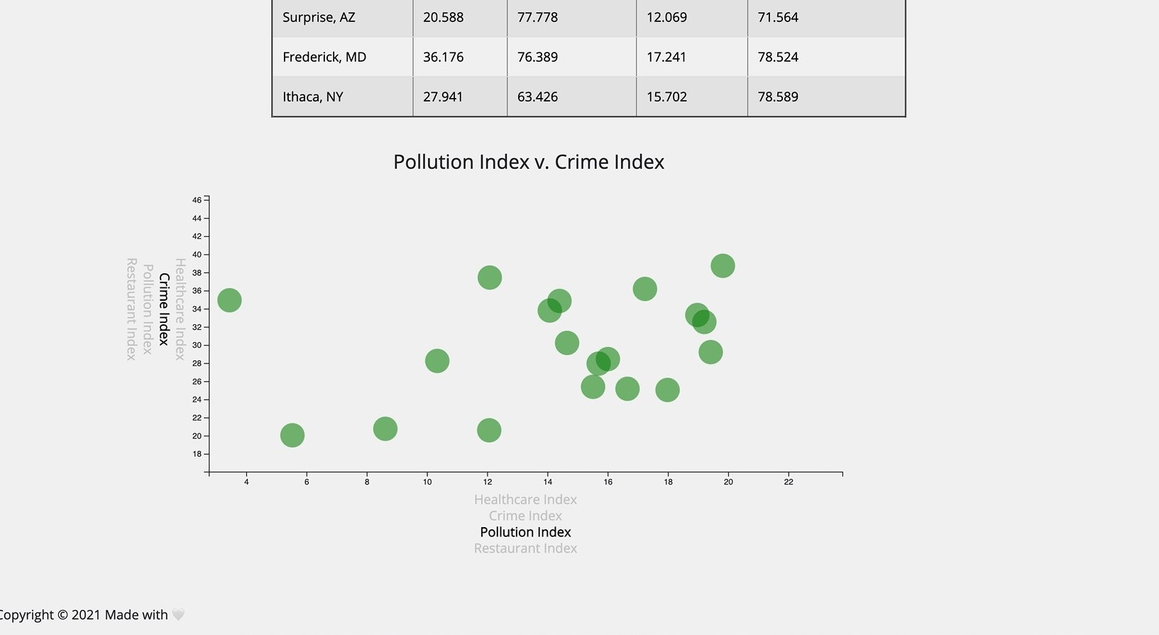

Slide 20
Questions
Thank You!

